Slide 1


Design Verification – An Introduction
Testing & Verification
Dept. of Computer Science & Engg, IIT Kharagpur
Pallab Dasgupta
Professor, Dept. of Computer Science & Engg.,
Professor-in-charge, AVLSI Design Lab,
Indian Institute of Technology Kharagpur

Slide 2


Main References
Hardware Design Verification: Simulation and
Formal Method-Based Approaches
William K Lam
Prentice Hall Modern Semiconductor Design Series
A Roadmap for Formal Property Verification
Pallab Dasgupts
Springer
Course Web: http://www.facweb.iitkgp.ernet.in/~pallab and follow link to courses

Slide 3
Design, Validation and Testing
Specification
Implementation
Design synthesis
and validation
Pre-silicon
Post-silicon
Prototyping
Manufacturing
and testing
Manufacturing

Slide 4
Design and Verification
Design
Specification
Implementation
Equivalent?
Verification

Slide 5
Design Challenges
Suppose we have to design
a pacemaker
Resource optimization
Reduce Cost
Test automation and
Design-for-Test
Improve Testability
Algorithms for
better yield
Improve Reliability
Improve Verifiability
Verification reliability
and coverage
Minimize Power
Power optimization during synthesis
Minimize Area
Area optimization during synthesis
Minimize Delay
Delay optimization during synthesis

Slide 6
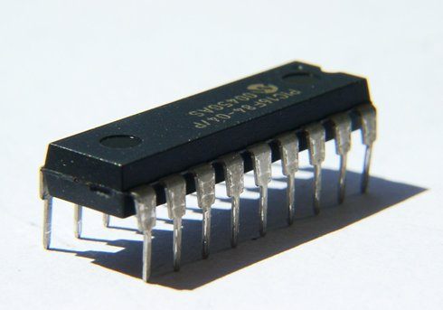
Digital Design: Abstraction Levels
Formalisms introduced
at the Entry-Level
Exponential growth
in circuit size
(Moore’s Law)
Register Transfer Level
always @( posedge clk )
begin
if (!rst) begin a1 <= a2;
a2 <= ~a1; end;
end
Restricted semantics of
Programming Languages,
Communicating Concurrent State Machines (CSM)
Gate Level
Boolean Logic
Finite State Machines
Transistor
Level
Schematic

Slide 7
Design Example: 2-bit Gray Counter
Gray Counter: Successive values should differ only in one bit. Reset signal
resets the counter to zero.
rst
rst
s₀
s₁
00
!rst
01
rst
rst
!rst
rst
!rst
clk
10
11
!rst
State m/c Representation

Slide 8
Design Example: 2-bit Gray Counter
s₀
State Transition Table
s₁
rst
(s₀s₁) | rst | (n₀n₁)
00 | 0 | 01
00 | 1 | 00
01 | 0 | 11
01 | 1 | 00
10 | 0 | 00
10 | 1 | 00
11 | 0 | 10
11 | 1 | 00
clk
rst
rst
00
!rst
01
rst
!rst
rst
!rst
10
11
!rst
State m/c Representation

Slide 9
Design Example: 2-bit Gray Counter
State Transition Table
State Transition Functions:
(s₀s₁) | rst | (n₀n₁)
00 | 0 | 01
00 | 1 | 00
01 | 0 | 11
01 | 1 | 00
10 | 0 | 00
10 | 1 | 00
11 | 0 | 10
11 | 1 | 00
n₀ = s₀′s₁r′ + s₀s₁r′
n₁ = s₀′s₁′r′ + s₀′s₁r′
After Logic Minimization:
n₀ = s₁r′
n₁ = s₀′r′

Slide 10
Design Example: 2-bit Gray Counter
State Transition Functions:
n₀ = s₁r′
n₁ = s₀′r′
Verilog Code (RTL):
module GrayCounter(s0, s1, rst)
input rst;
reg s0, s1;
always @ (posedge clk)
begin
s0 <= s1 & ~rst;
s1 <= ~s0 & ~rst;
end
endmodule
rst
s₀
s₁
Synthesis
clk

Slide 11
Abstractions in Design Flow
higher
Functional Specification
less
Algorithmic Description
RTL
abstraction
details
Gate Netlist
Transistor Netlist
lower
Physical Layout
more

Slide 12
Design and Verification
specifications
does it meet the specs?
property
checking
micro-architecture
does it implement the μ-arch?
design
RTL
verification
are they equivalent?
gate netlist
equivalence
checking
are they equivalent?
layout

